Slide 1


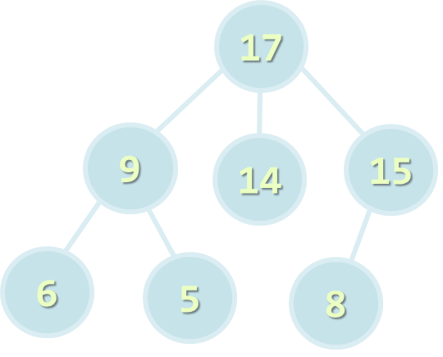

Basic Tree Data Structures
Trees, Binary Trees, Traversals
Tree-Like Structures
SoftUni Team
Technical Trainers
Software University
http://softuni.bg

Slide 2

Table of Contents
Tree-like Data Structures
Trees and Related Terminology
Implementing Trees
DFS and BFS
Binary Trees and Traversals
Pre-order (node, left, right)
In-order (left, node, right)
Post-order (left, right, node)

Slide 3
Have a Question?
sli.do #DsAlgo

Slide 4
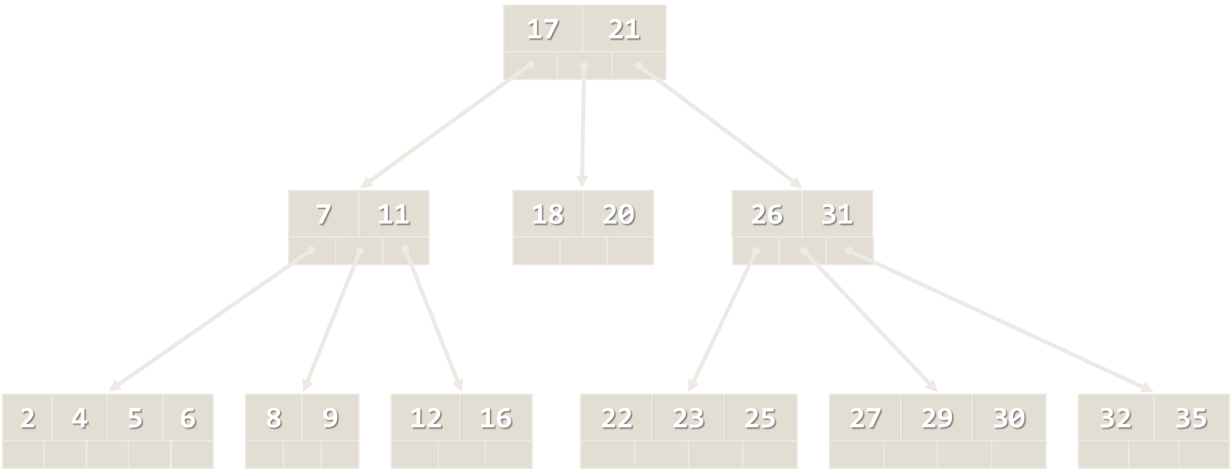
Tree-like Data Structures
Trees, Binary Trees

Slide 5
Tree-like Data Structures
Tree-like data structures are:
Branched recursive data structures
Consisting of nodes
Each node connected to other nodes
Tree
17
*
Binary Tree
9
14
15
+
-
6
5
8
3
2
9
6

Slide 6
Tree-like Data Structures
Examples of tree-like structures
Trees: binary, balanced, ordered, etc.
Graphs: directed / undirected, weighted, etc.
Networks: graphs with particular attributes
Network
Graph
5 (20)
2
7
1
1
5 (10)
14
10 (40)
4
6
20(20)
21
15 (15)
3
11
15 (30)
5 (5)
12
19
31
4
5

Slide 7
Trees and Related Terminology
Project Manager
Team Leader
Designer
QA Team Leader
Node, Edge, Root, etc.

Slide 8
Tree Data Structure – Terminology
Node, Edge
Root, Parent, Child, Sibling
Depth, Height
Subtree
Internal node, Leaf
Ancestor, Descendant
Root
17
Depth 0
9
14
15
Depth 1
6
5
8
Depth 2
Leaf
Height = 3

Slide 9
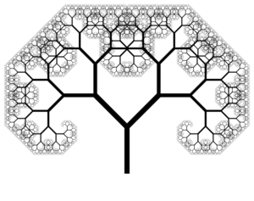
Implementing Trees
Recursive Tree Data Structure

Slide 10
Recursive Tree Definition
The recursive definition for tree data structure:
A single node is a tree
Nodes have zero or multiple children that are also trees
public class Tree<T>
{
private T value;
private IList<Tree<T>> children;
…
}
The stored value
List of child nodes

Slide 11
Tree<int> Structure – Example
IList<Tree<int>> children
int value
7
children
Tree<int>
19
children
21
children
14
children
1
children
31
children
23
children
6
children
12
children

Slide 12
Problem: Implement Tree Node
Create a recursive tree definition in order to create trees
Tree<int> tree =
new Tree<int>(7,
new Tree<int>(19,
new Tree<int>(1),
new Tree<int>(12),
new Tree<int>(31)),
new Tree<int>(21),
new Tree<int>(14,
new Tree<int>(23),
new Tree<int>(6))
);
7
19
21
14
1
12
31
23
6

Slide 13
Solution: Implement Tree Node
public class Tree<T>
{
public T Value { get; set; }
public IList<Tree<T>> Children { get; private set; }
public Tree(T value, params Tree<T>[] children)
{
this.Value = value;
this.Children = new List<Tree<T>>();
foreach (var child in children)
this.Children.Add(child);
}
}
Flexible constructor for building trees

Slide 14
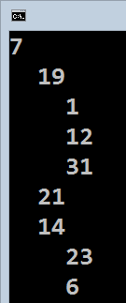
Problem: Printing a Tree
Print a tree at the console (each level +2 intervals, starting at 0)
Tree<int> tree =
new Tree<int>(7,
new Tree<int>(19,
new Tree<int>(1),
new Tree<int>(12),
new Tree<int>(31)),
new Tree<int>(21),
new Tree<int>(14,
new Tree<int>(23),
new Tree<int>(6))
);

Slide 15
Solutions: Printing a Tree
Printing a tree at the console – recursive algorithm
public class Tree<T>
{
…
public void Print(int indent = 0)
{
Console.Write(new string(' ', 2 * indent));
Console.WriteLine(this.Value);
foreach (var child in this.Children)
child.Print(indent + 1);
}
}

Slide 16
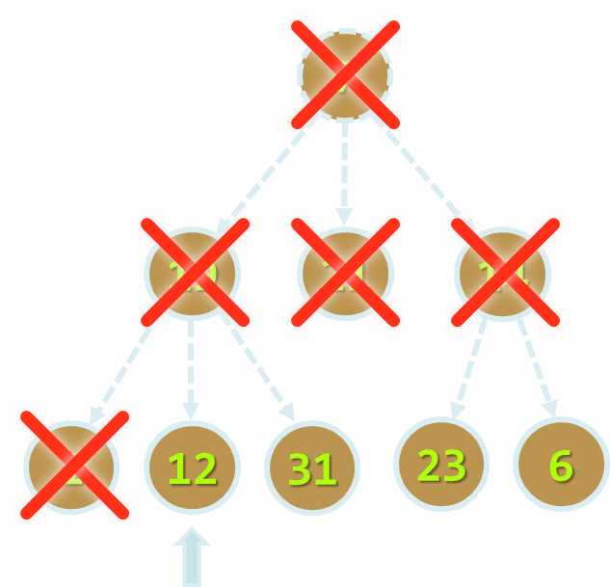
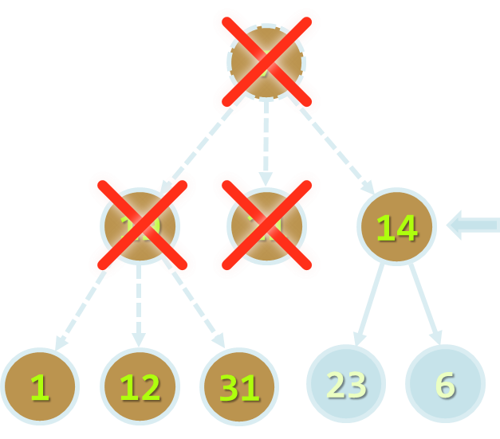
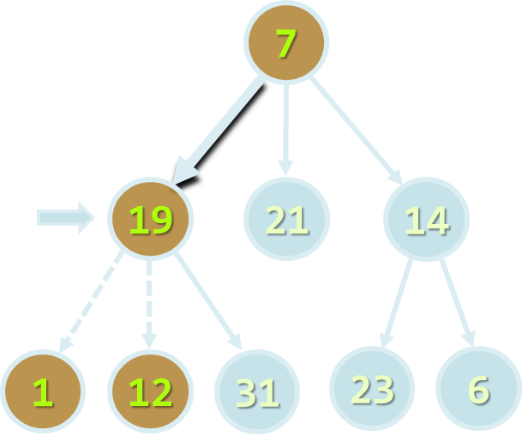
Traversing Tree-Like Structures
DFS and BFS Traversals

Slide 17

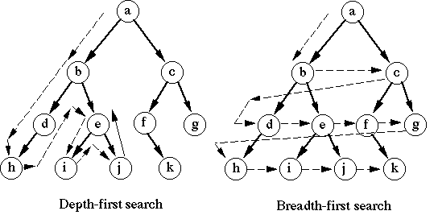
Tree Traversal Algorithms
Traversing a tree means to visit each of its nodes exactly once
The order of visiting nodes may vary on the traversal algorithm
Depth-First Search (DFS)
Visit node's successors first
Usually implemented by recursion
Breadth-First Search (BFS)
Nearest nodes visited first
Implemented by a queue

Slide 18
Depth-First Search (DFS)
Depth-First Search (DFS) first visits all descendants of given node recursively, finally visits the node itself
DFS algorithm pseudo code:
9
7
DFS (node)
{
for each child c of node
DFS(c);
print node;
}
4
19
5
21
8
14
1
2
3
6
7
1
12
31
23
6

Slide 19
DFS in Action (Step 1)
Stack: 7
Output: (empty)
Start DFS from the tree root
7
19
21
14
1
12
31
23
6

Slide 20
DFS in Action (Step 2)
Stack: 7, 19
Output: (empty)
Enter recursively into the first child
7
19
21
14
1
12
31
23
6

Slide 21
DFS in Action (Step 3)
Stack: 7, 19, 1
Output: (empty)
Enter recursively into the first child
7
19
21
14
1
12
31
23
6

Slide 22
DFS in Action (Step 4)
Stack: 7, 19
Output: 1
Return back from recursion and print the last visited node
7
19
21
14
1
12
31
23
6

Slide 23
DFS in Action (Step 5)
Stack: 7, 19, 12
Output: 1
Enter recursively into the first child
7
19
21
14
1
12
31
23
6

Slide 24
DFS in Action (Step 6)
Stack: 7, 19
Output: 1, 12
Return back from recursion and print the last visited node
7
19
21
14
1
12
31
23
6

Slide 25
DFS in Action (Step 7)
Stack: 7, 19, 31
Output: 1, 12
Enter recursively into the first child
7
19
21
14
1
12
31
23
6

Slide 26
DFS in Action (Step 8)
Stack: 7, 19
Output: 1, 12, 31
Return back from recursion and print the last visited node
7
19
21
14
1
12
31
23
6

Slide 27
DFS in Action (Step 9)
Stack: 7
Output: 1, 12, 31, 19
Return back from recursion and print the last visited node
7
19
21
14
1
12
31
23
6

Slide 28
DFS in Action (Step 10)
Stack: 7, 21
Output: 1, 12, 31, 19
Enter recursively into the first child
7
19
21
14
1
12
31
23
6

Slide 29
DFS in Action (Step 11)
Stack: 7
Output: 1, 12, 31, 19, 21
Return back from recursion and print the last visited node
7
19
21
14
1
12
31
23
6

Slide 30
DFS in Action (Step 12)
Stack: 7, 14
Output: 1, 12, 31, 19, 21
Enter recursively into the first child
7
19
21
14
1
12
31
23
6

Slide 31
DFS in Action (Step 13)
Stack: 7, 14, 23
Output: 1, 12, 31, 19, 21
Enter recursively into the first child
7
19
21
14
1
12
31
23
6

Slide 32
DFS in Action (Step 14)
Stack: 7, 14
Output: 1, 12, 31, 19, 21, 23
Return back from recursion and print the last visited node
7
19
21
14
1
12
31
23
6

Slide 33
DFS in Action (Step 15)
Stack: 7, 14, 6
Output: 1, 12, 31, 19, 21, 23
Enter recursively into the first child
7
19
21
14
1
12
31
23
6

Slide 34
DFS in Action (Step 16)
Stack: 7, 14
Output: 1, 12, 31, 19, 21, 23, 6
Return back from recursion and print the last visited node
7
19
21
14
1
12
31
23
6

Slide 35
DFS in Action (Step 17)
Stack: 7
Output: 1, 12, 31, 19, 21, 23, 6, 14
Return back from recursion and print the last visited node
7
19
21
14
1
12
31
23
6

Slide 36
DFS in Action (Step 18)
Stack: (empty)
Output: 1, 12, 31, 19, 21, 23, 6, 14, 7
DFS traversal finished
7
19
21
14
1
12
31
23
6

Slide 37
Problem: Order DFS
Given the Tree<T> structure, define a method
IEnumerable<T> OrderDFS()
That returns elements in order of DFS algorithm visiting them
7
19
21
14
1 12 31 19 21 23 6 14 7
1
12
31
23
6

Slide 38
Solution: Order DFS
public IEnumerable<T> OrderDFS()
{
List<T> order = new List<T>();
this.DFS(this, order);
return order;
}
private void DFS(Tree<T> tree, List<T> order)
{
foreach (var child in tree.Children)
this.DFS(child, order);
order.Add(tree.Value);
}

Slide 39
Breadth-First Search (BFS)
Breadth-First Search (BFS) first visits the neighbor nodes, then the neighbors of neighbors, etc.
BFS algorithm pseudo code:
1
7
BFS (node)
{
queue ← node
while queue not empty
v ← queue
print v
for each child c of v
queue ← c
}
2
19
3
21
4
14
5
6
7
8
9
1
12
31
23
6

Slide 40
BFS in Action (Step 1)
Queue: 7
Output:
Initially enqueue the root node
7
19
21
14
1
12
31
23
6

Slide 41
BFS in Action (Step 2)
Queue: 7
Output: 7
Remove from the queue the next node and print it
7
19
21
14
1
12
31
23
6

Slide 42
BFS in Action (Step 3)
Queue: 7, 19
Output: 7
Enqueue all children of the current node
7
19
21
14
1
12
31
23
6

Slide 43
BFS in Action (Step 4)
Queue: 7, 19, 21
Output: 7
Enqueue all children of the current node
7
19
21
14
1
12
31
23
6

Slide 44
BFS in Action (Step 5)
Queue: 7, 19, 21, 14
Output: 7
Enqueue all children of the current node
7
19
21
14
1
12
31
23
6

Slide 45
BFS in Action (Step 6)
Queue: 7, 19, 21, 14
Output: 7, 19
Remove from the queue the next node and print it
7
19
21
14
1
12
31
23
6

Slide 46
BFS in Action (Step 7)
Queue: 7, 19, 21, 14, 1
Output: 7, 19
Enqueue all children of the current node
7
19
21
14
1
12
31
23
6

Slide 47
BFS in Action (Step 8)
Queue: 7, 19, 21, 14, 1, 12
Output: 7, 19
Enqueue all children of the current node
7
19
21
14
1
12
31
23
6

Slide 48
BFS in Action (Step 9)
Queue: 7, 19, 21, 14, 1, 12, 31
Output: 7, 19
Enqueue all children of the current node
7
19
21
14
1
12
31
23
6

Slide 49
BFS in Action (Step 10)
Queue: 7, 19, 21, 14, 1, 12, 31
Output: 7, 19, 21
Remove from the queue the next node and print it
7
19
21
14
No child nodes to enqueue
1
12
31
23
6

Slide 50
BFS in Action (Step 11)
Queue: 7, 19, 21, 14, 1, 12, 31
Output: 7, 19, 21, 14
Remove from the queue the next node and print it
7
19
21
14
1
12
31
23
6

Slide 51
BFS in Action (Step 12)
Queue: 7, 19, 21, 14, 1, 12, 31, 23
Output: 7, 19, 21, 14
Enqueue all children of the current node
7
19
21
14
1
12
31
23
6

Slide 52
BFS in Action (Step 13)
Queue: 7, 19, 21, 14, 1, 12, 31, 23, 6
Output: 7, 19, 21, 14
Enqueue all children of the current node
7
19
21
14
1
12
31
23
6

Slide 53
BFS in Action (Step 14)
Queue: 7, 19, 21, 14, 1, 12, 31, 23, 6
Output: 7, 19, 21, 14, 1
Remove from the queue the next node and print it
7
19
21
14
No child nodes to enqueue
1
12
31
23
6

Slide 54
BFS in Action (Step 15)
Queue: 7, 19, 21, 14, 1, 12, 31, 23, 6
Output: 7, 19, 21, 14, 1, 12
Remove from the queue the next node and print it
7
19
21
14
No child nodes to enqueue
1
12
31
23
6

Slide 55
BFS in Action (Step 16)
Queue: 7, 19, 21, 14, 1, 12, 31, 23, 6
Output: 7, 19, 21, 14, 1, 12, 31
Remove from the queue the next node and print it
7
19
21
14
No child nodes to enqueue
1
12
31
23
6

Slide 56
BFS in Action (Step 17)
Queue: 7, 19, 21, 14, 1, 12, 31, 23, 6
Output: 7, 19, 21, 14, 1, 12, 31, 23
Remove from the queue the next node and print it
7
19
21
14
No child nodes to enqueue
1
12
31
23
6

Slide 57
BFS in Action (Step 18)
Queue: 7, 19, 21, 14, 1, 12, 31, 23, 6
Output: 7, 19, 21, 14, 1, 12, 31, 23, 6
Remove from the queue the next node and print it
7
19
21
14
No child nodes to enqueue
1
12
31
23
6

Slide 58
BFS in Action (Step 19)
Queue: 7, 19, 21, 14, 1, 12, 31, 23, 6
Output: 7, 19, 21, 14, 1, 12, 31, 23, 6
The queue is empty → stop
7
19
21
14
1
12
31
23
6

Slide 59
Problem: Order BFS
Given the Tree<T> structure, define a method
IEnumerable<T> OrderBFS()
That returns elements in order of BFS algorithm visiting them
7
19
21
14
7 19 21 14 1 12 31 23 6
1
12
31
23
6

Slide 60
Solution: Order DFS
public IEnumerable<T> OrderBFS()
{
var result = new List<T>();
var queue = new Queue<Tree<T>>();
queue.Enqueue(this);
while (queue.Count > 0)
{
var current = queue.Dequeue();
result.Add(current.Value);
foreach (var child in current.Children)
queue.Enqueue(child);
}
return result;
}

Slide 61
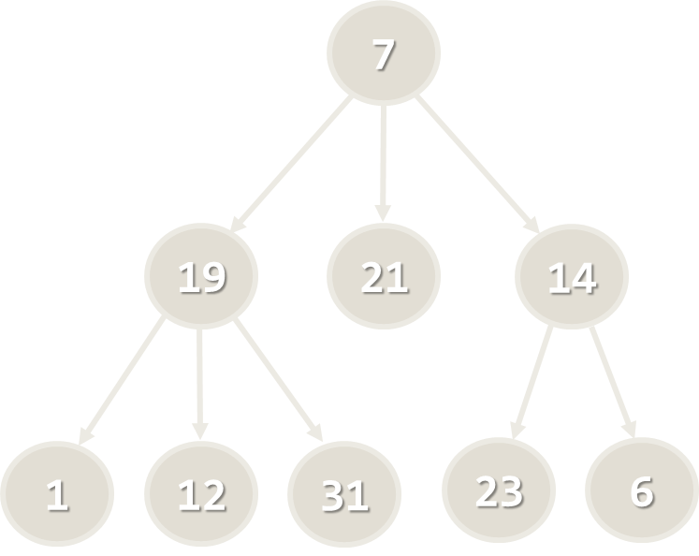
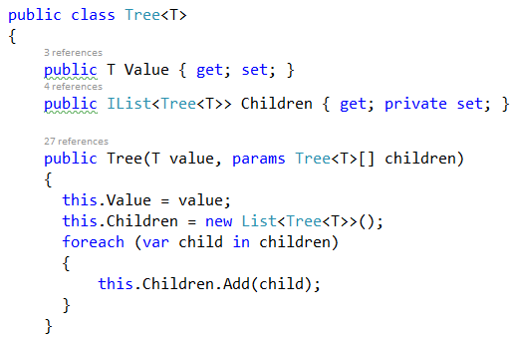
Lab Exercise
Trees and Trees Traversals (DFS, BFS)

Slide 62
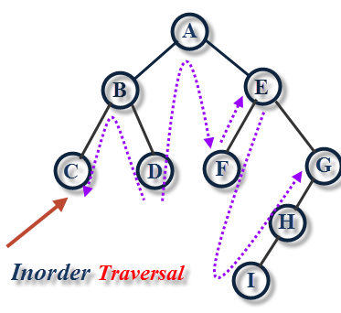
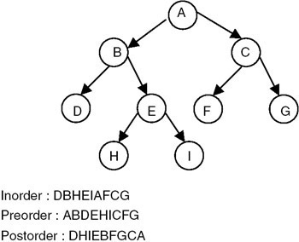
Binary Trees and BT Traversals
Preorder, In-Order, Post-Order

Slide 63
Binary Trees
Binary trees: the most widespread form
Each node has at most 2 children (left and right)
Root node
17
Right child
Left
subtree
9
15
6
5
8
Left child

Slide 64
Binary Trees Traversal: Pre-order
Root → Left → Right
17
PreOrder (node)
{
if (node != null)
print node.Value
PreOrder(node.Left)
PreOrder(node.Right)
}
9
25
3
11
20
31
→ 17 9 3 11 25 20 13

Slide 65
Binary Trees Traversal: In-order
Left → Root → Right
17
InOrder (node)
{
if (node != null)
PreOrder(node.Left)
print node.Value
PreOrder(node.Right)
}
9
25
3
11
20
31
→ 3 9 11 17 20 25 31
BST: Sorted Order

Slide 66
Binary Trees Traversal: Post-order
Left → Right → Root
17
InOrder (node)
{
if (node != null)
PreOrder(node.Left)
PreOrder(node.Right)
print node.Value
}
9
25
3
11
20
31
→ 3 11 9 17 20 31 25

Slide 67
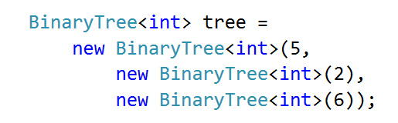
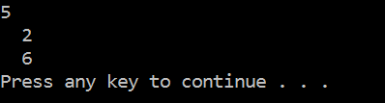
Problem: Binary Tree Traversals
You are given a skeleton
Implement BinaryTree<T>
Implement PrintIndentedPreOrder(), each level indented +2
EachInOrder and EachPostOrder
Apply a function (Action<T>) over a nodes value

Slide 68
Solution: BT Traversals - Constructor
public BinaryTree(
T value,
BinaryTree<T> leftChild = null,
BinaryTree<T> rightChild = null)
{
this.Value = value;
this.LeftChild = leftChild;
this.RightChild = rightChild;
}

Slide 69
Solution: BT Traversals - Print
public void PrintIndentedPreOrder(int indent = 0)
{
Console.WriteLine(new string(' ', indent) + this.Value);
if (this.LeftChild != null)
{
this.LeftChild.PrintIndentedPreOrder(indent + 2);
}
if (this.RightChild != null)
{
this.RightChild.PrintIndentedPreOrder(indent + 2);
}
}
Process Node
Traverse Left
Traverse Right

Slide 70
Solution: BT Traversals - EachInOrder
public void EachInOrder(Action<T> action)
{
if (this.LeftChild != null)
{
this.LeftChild.EachInOrder(action);
}
action(this.Value);
if (this.RightChild != null)
{
this.RightChild.EachInOrder(action);
}
}
Traverse Left
Process Node
Traverse Right

Slide 71
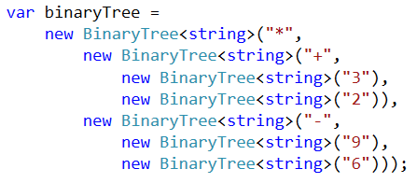
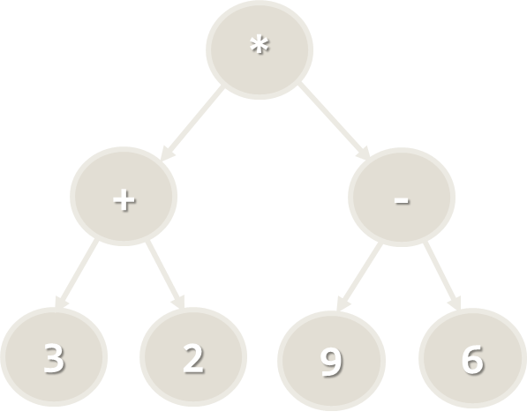
Lab Exercise
Binary Trees and Traversal

Slide 72
Summary
Trees are recursive data structures
A tree is a node holding a set of children (which are also nodes)
Edges connect Nodes
DFS → children first, BFS → root first
Binary trees have no more than two children
Pre-Order → Root, Left, Right
In-Order → Left, Root, Right
Post-Order → Left, Right, Root

Slide 73







Trees and Tree-Like Structures
https://softuni.bg/opencourses/data-structures

Slide 74
License
This course (slides, examples, demos, videos, homework, etc.) is licensed under the "Creative Commons Attribution-NonCommercial-ShareAlike 4.0 International" license

Slide 75




Trainings @ Software University (SoftUni)
Software University – High-Quality Education, Profession and Job for Software Developers
softuni.bg
Software University Foundation
softuni.org
Software University @ Facebook
facebook.com/SoftwareUniversity
Software University Forums
forum.softuni.bg

